Slide 1

ePahiram:
Loan Management System
www.collaberadigital.com

Slide 2
Personal BACKGROUND
(Name, Past Experience, Qualification, Career Summary)
Name : Johnjason M. Coligado
Qualification: Tech Stack
Programming Languages & Database: C#, C++, Python, Java, and MsSQL.
Frameworks: Asp.net, Asp.net Core
Deployment Tools: Docker & Kubernetes
Game Development: Unity 3D
Career Summary :
Graduated with a BS Computer Engineering degree, has the title for the best capstone project (A.Y 2021-2022) entitled Arduino Based Kine Bike Simulation, and is also one of the capstone studies published and patented by the Laguna State Polytechnic University San Pablo City Campus. Former Vice President External of the Association of Students in Computer Engineering (ASCpE), one of the Trainee students of Continental Temic Philippines absorbed as Jr. IT Engineer.

Slide 3
Personal BACKGROUND
(Name, Past Experience, Qualification, Career Summary)
Name : Jhansept Kylo Pandanan
Qualification : Tech Stack
Programming Languages & Database: C#, C++, Python, Java, and MS SQL.
Frameworks: Asp.net, Asp.net Core
Deployment Tools: Docker & Kubernetes
Career Summary : Jhansept Kylo Pandanan, a graduate of Computer engineering. The former Vice-President Internal of the Association of Students in Computer Engineering of their University. Had his Internship at Automated Technologies Inc. from May 2022 to July 2022 - working along with the Network engineers to provide support and assistance in building and configuring physical servers.

Slide 4
Key Takeaways/Learnings from the Program (HTD)
Database Management:
Data normalization
Stored procedure
Asp.NET Framework
Dependency
Validations
MVC
Roles/Authorizations
Web API (Rest API)
Swagger
Postman
End points
Docker & Kubernetes
Deployment
Containerization

Slide 5
Problem Statement of the Capstone Project
Cebuana Lhuiller is currently upgrading its Micro Loan Services system, which unfortunately means that clients cannot currently apply for loans. However, the developers have responded to this issue by creating a new system that enables clients to apply for gadget loans and calculate their monthly payments using a loan calculator. This solution provides clients with a convenient and accessible way to obtain the funds they need for their gadget purchases, despite the temporary unavailability of Cebuana Lhuiller's Micro Loan Services.

Slide 6
Approach Note
The loan management system was built using Asp. Net MVC and dedicated frameworks, all data was handled with MS SQL and Entity Relationships, it is designed with Bootstrap and CSS components, and is deployed in docker and Kubernetes.
Approach:
Planning Phase
Design (ER Diagram and Wireframe creation)
Implementation
Testing
Deployment

Slide 7
In Scope
Loan Calculator: tool that helps users to estimate the amount of money they will have to pay each month to repay a loan based on the loan amount and the loan term they prefer. The user can input the loan amount and the preferred loan term (in months), and the calculator will compute the monthly payment and display the total amount payable. This helps the user to determine whether they can afford to make the loan payments and decide whether to proceed with the loan application.

Slide 8
In Scope
Gadget Loan: allows users to apply for a loan to purchase a gadget of their choice. However, users can only apply for one gadget at a time. The system admin has the authority to approve or decline user gadget loan applications. The admin has the capability to add a gadget for loaning by providing the gadget name, description, price, and image URL. The gadget will then be made available for users to apply for a gadget loan. The admin can also delete a gadget from the system. If the admin deletes a gadget, all the gadget loan applications associated with that gadget will also be deleted.

Slide 9
In Scope
Manage User Accounts: The admin can view the user details and has the authority to delete the user's account from the system.
View Purchases: The admin can view all the purchases made by the user and can approve or decline the user's loan applications. If the admin declines or if the user withdraws the loan application, it will be stored in the Archived Purchases section of the system. This feature helps the admin to manage the user accounts efficiently and provides a convenient way to view the user's loan history. All approved application will still be visible in the purchases section.

Slide 10
In Scope
Profiles: Users and Admins have access to their respective profiles where they can view their personal details such as name, email, gender, birthdate, address and contact information. Users and admin can also change their password from their profile settings. However, the system does not allow users or admin to modify any other user profile details other than their own. This ensures the security and privacy of each user's personal information. Additionally, this feature provides a convenient way for users and admin to manage their profile information and update their password if necessary.

Slide 11
In Scope
API: perform CRUD operations for the system administrator; additionally, the API uses JWT token authentication for the security of API calls that may reflect changes to the main system.

Slide 12
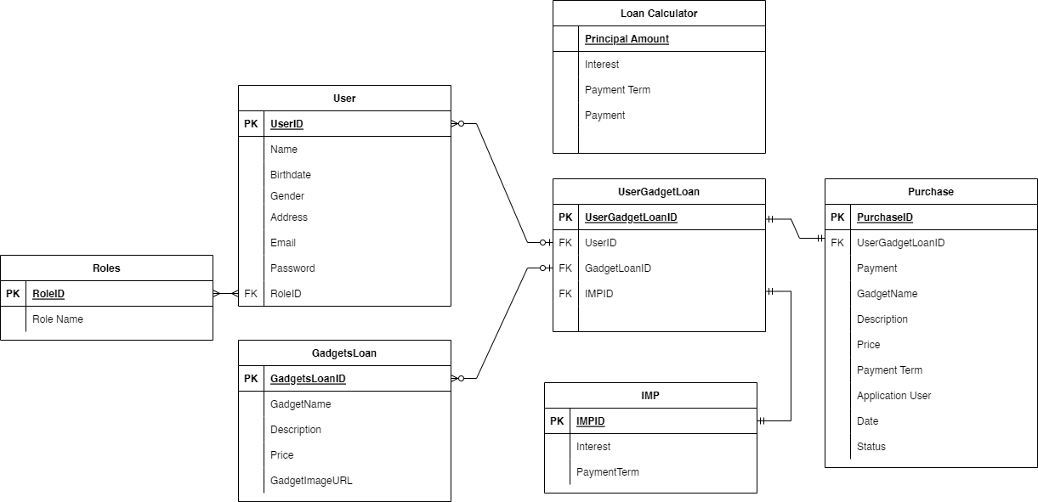
ER Diagram

Slide 13
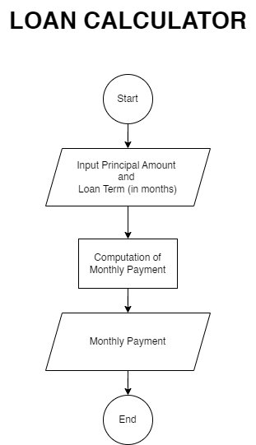
System Flowchart

Slide 14
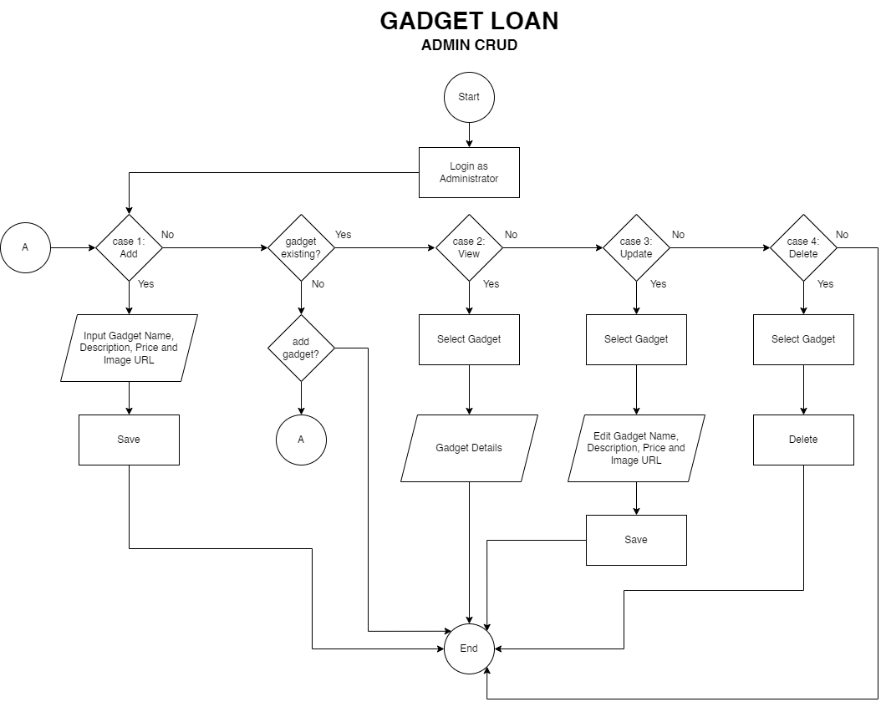
System Flowchart

Slide 15
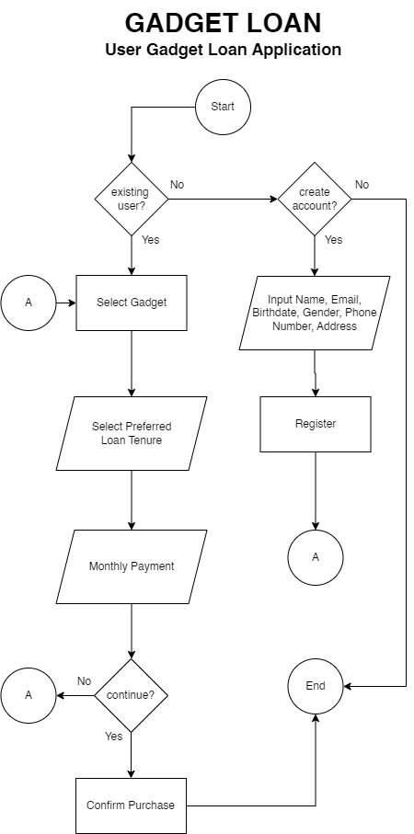
System Flowchart

Slide 16
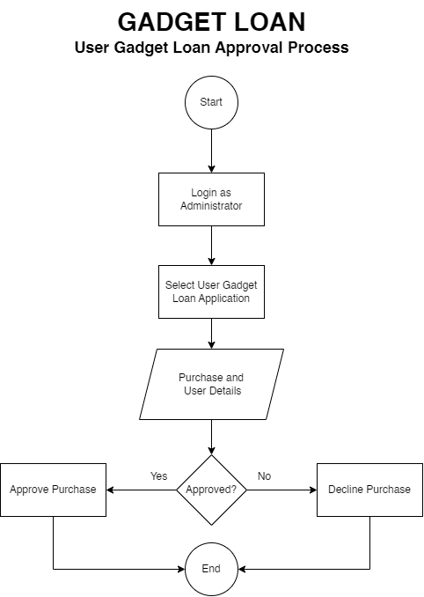
System Flowchart

Slide 17
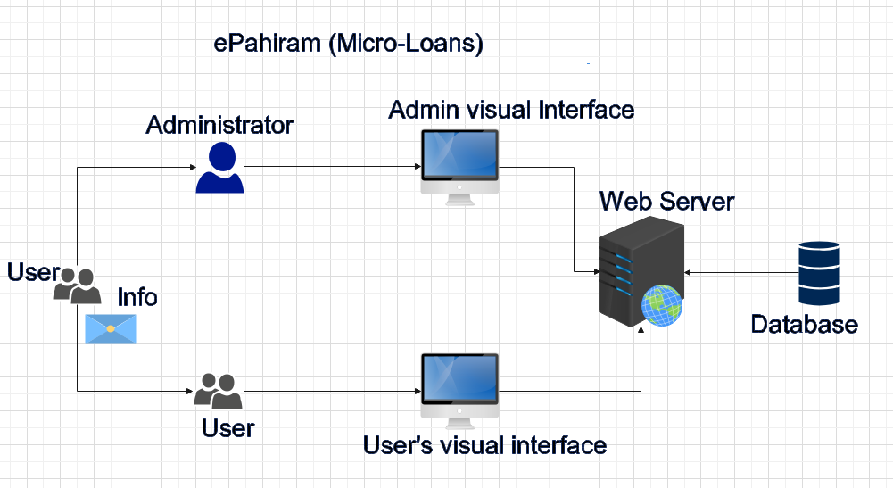
System Architecture

Slide 18

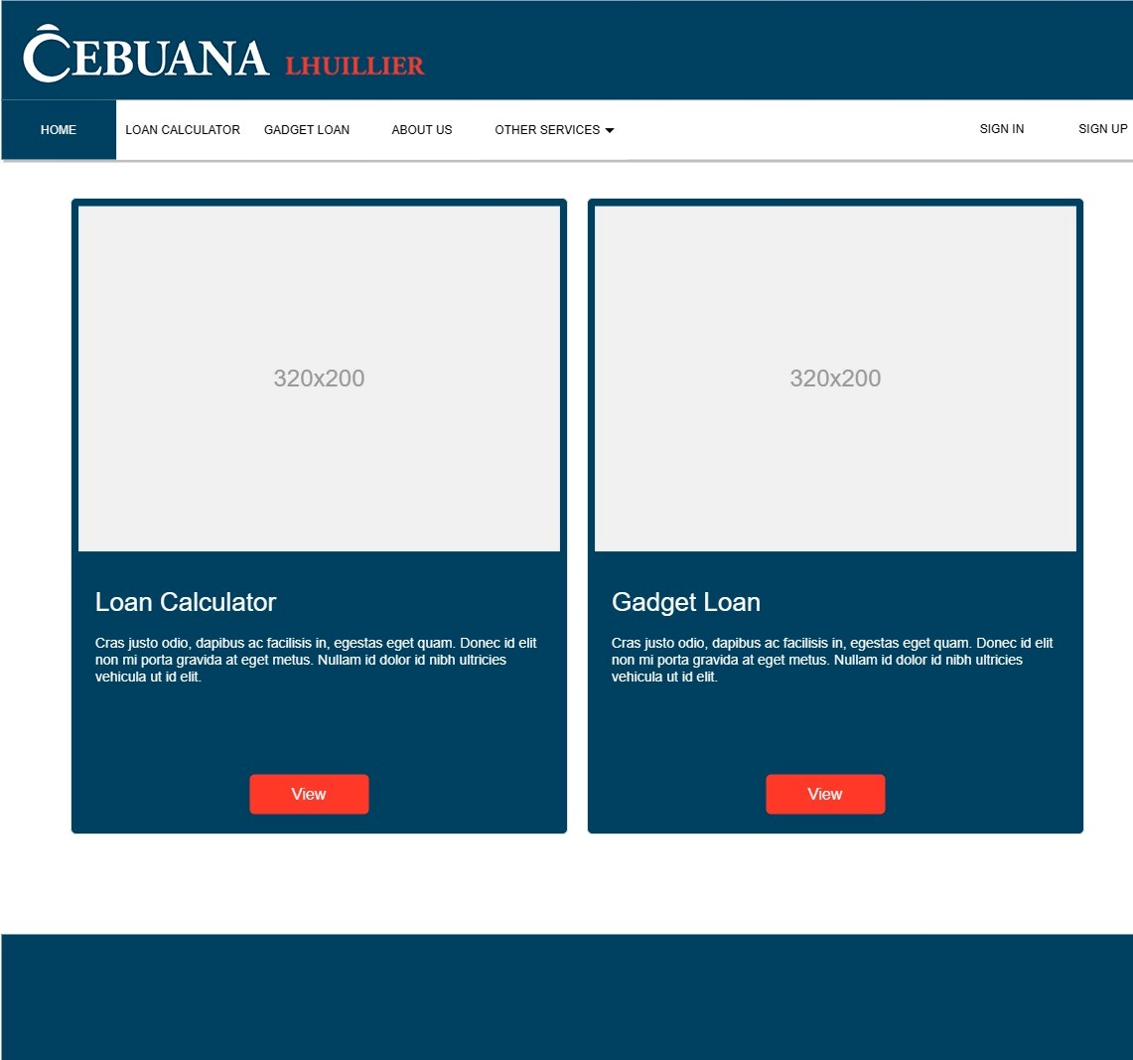

Wireframe/Architecture
www.collaberadigital.com

Slide 19
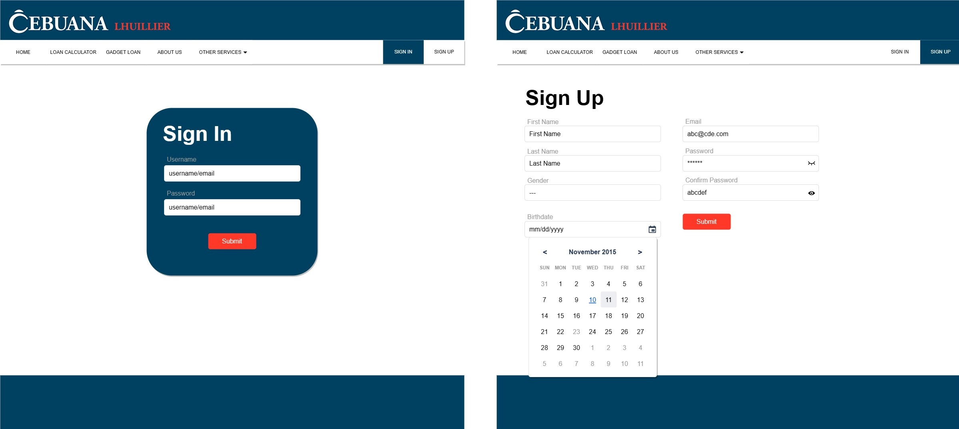
Wireframe

Slide 20
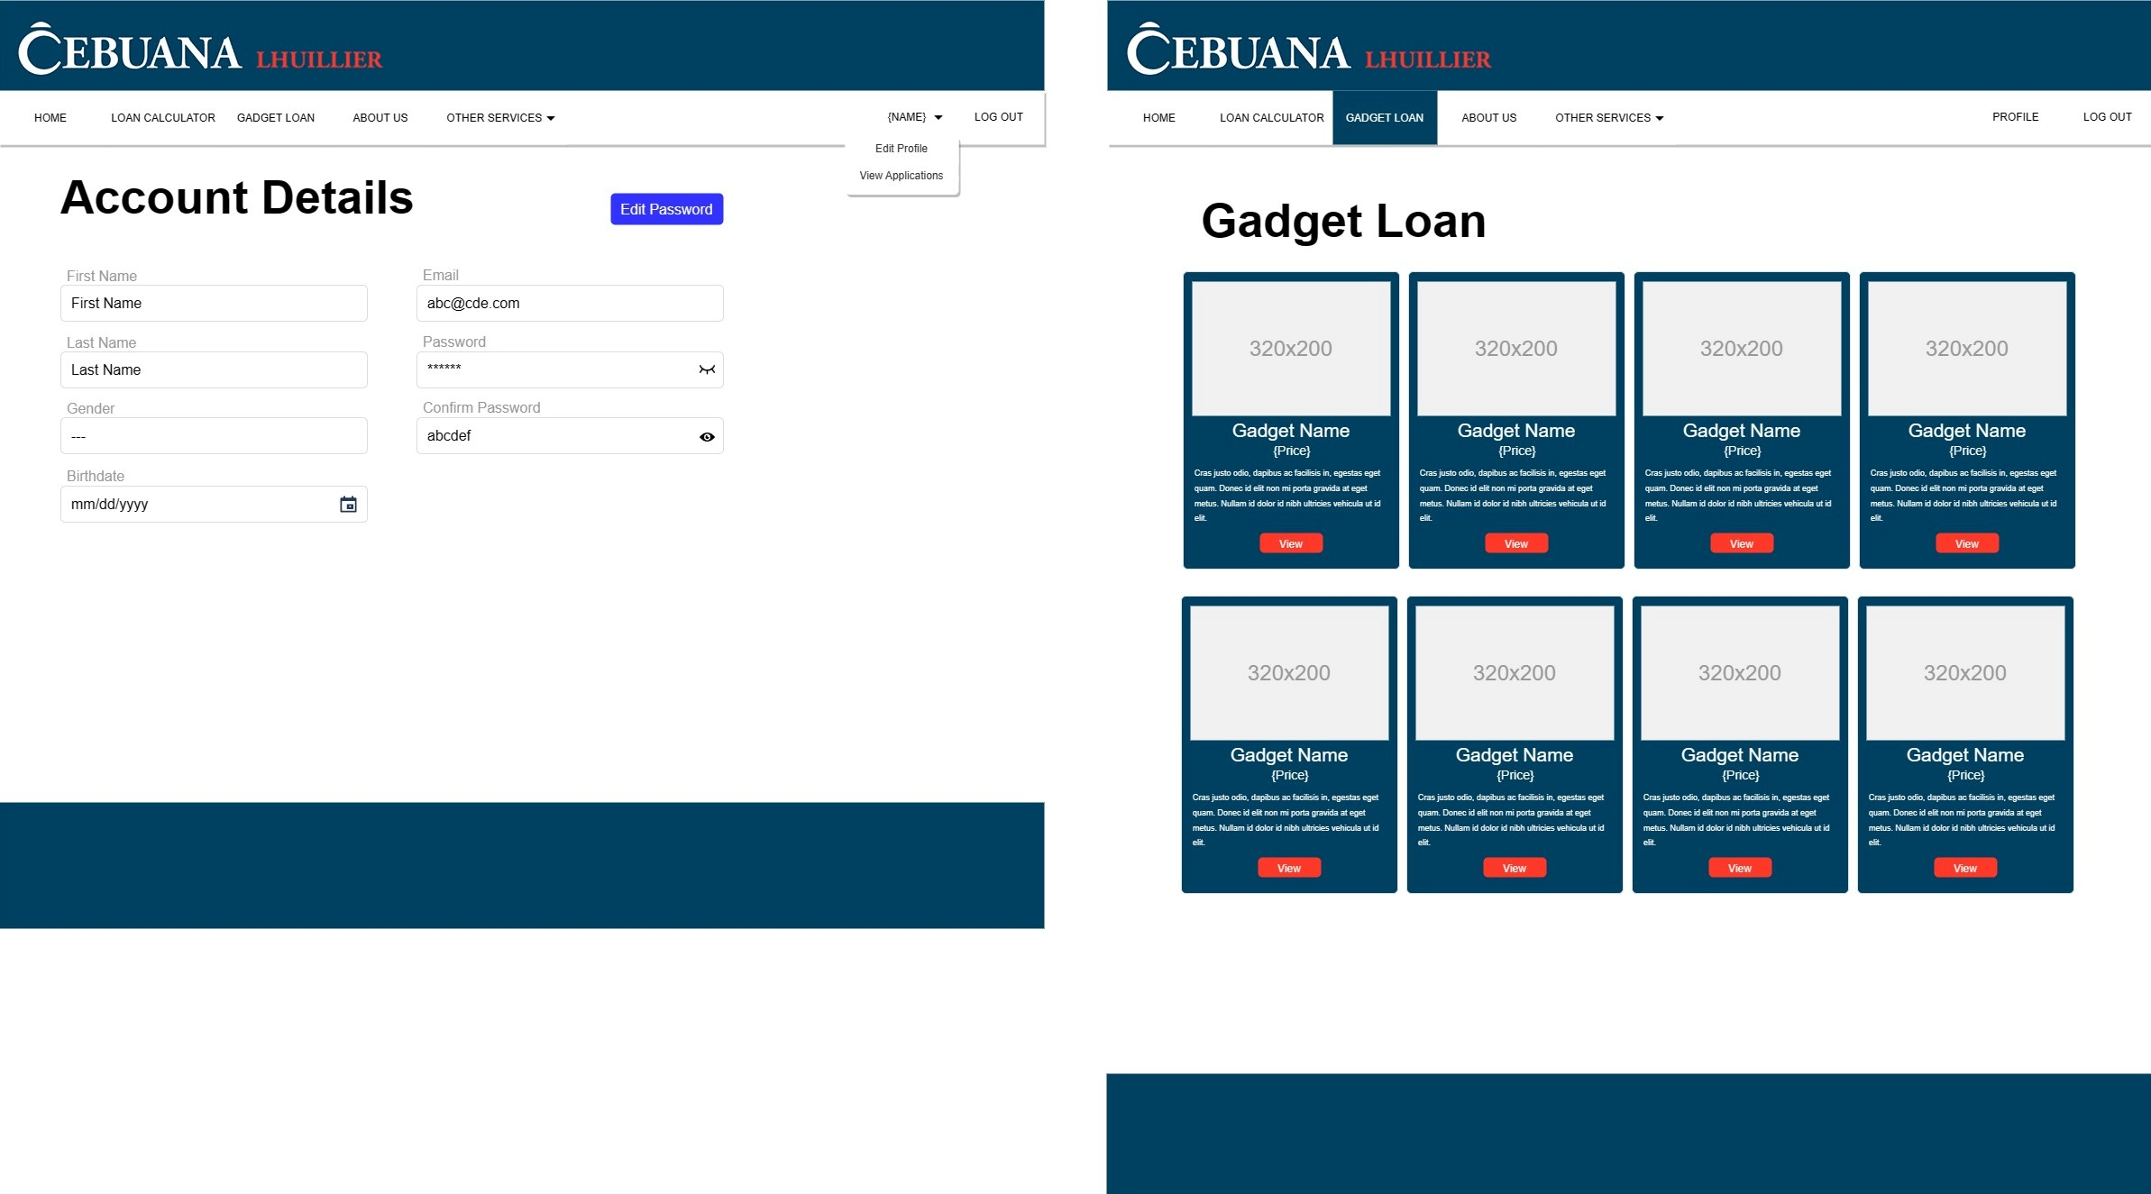
Wireframe

Slide 21
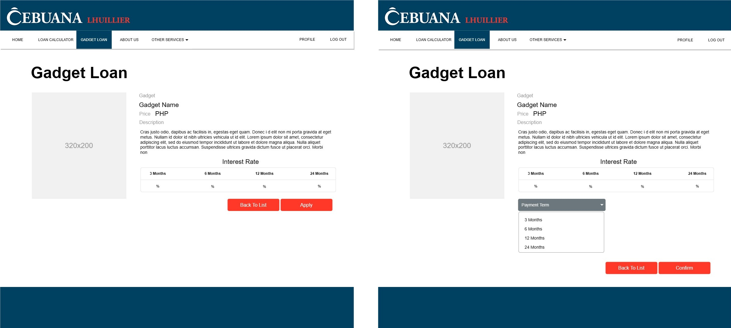
Wireframe

Slide 22
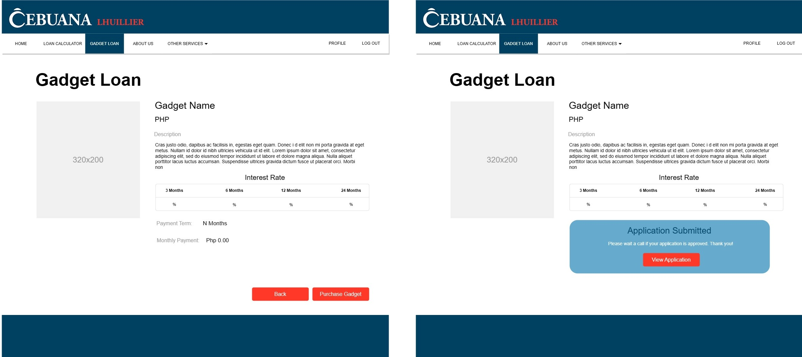
Wireframe

Slide 23
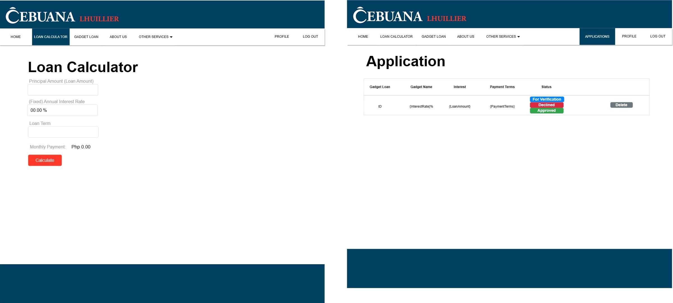
Wireframe

Slide 24
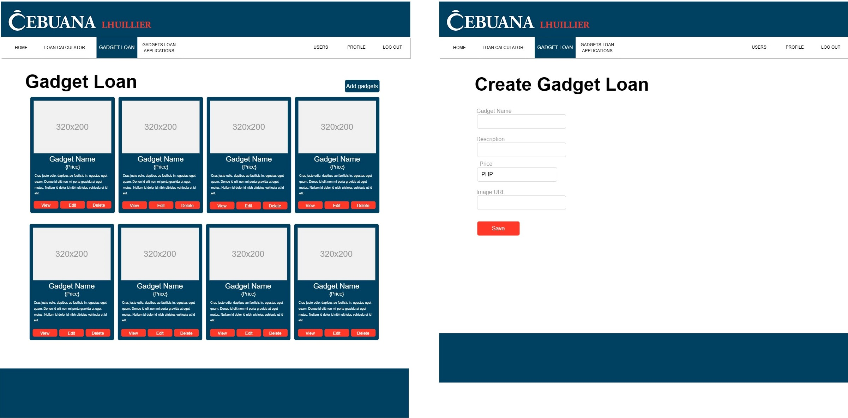
Wireframe

Slide 25
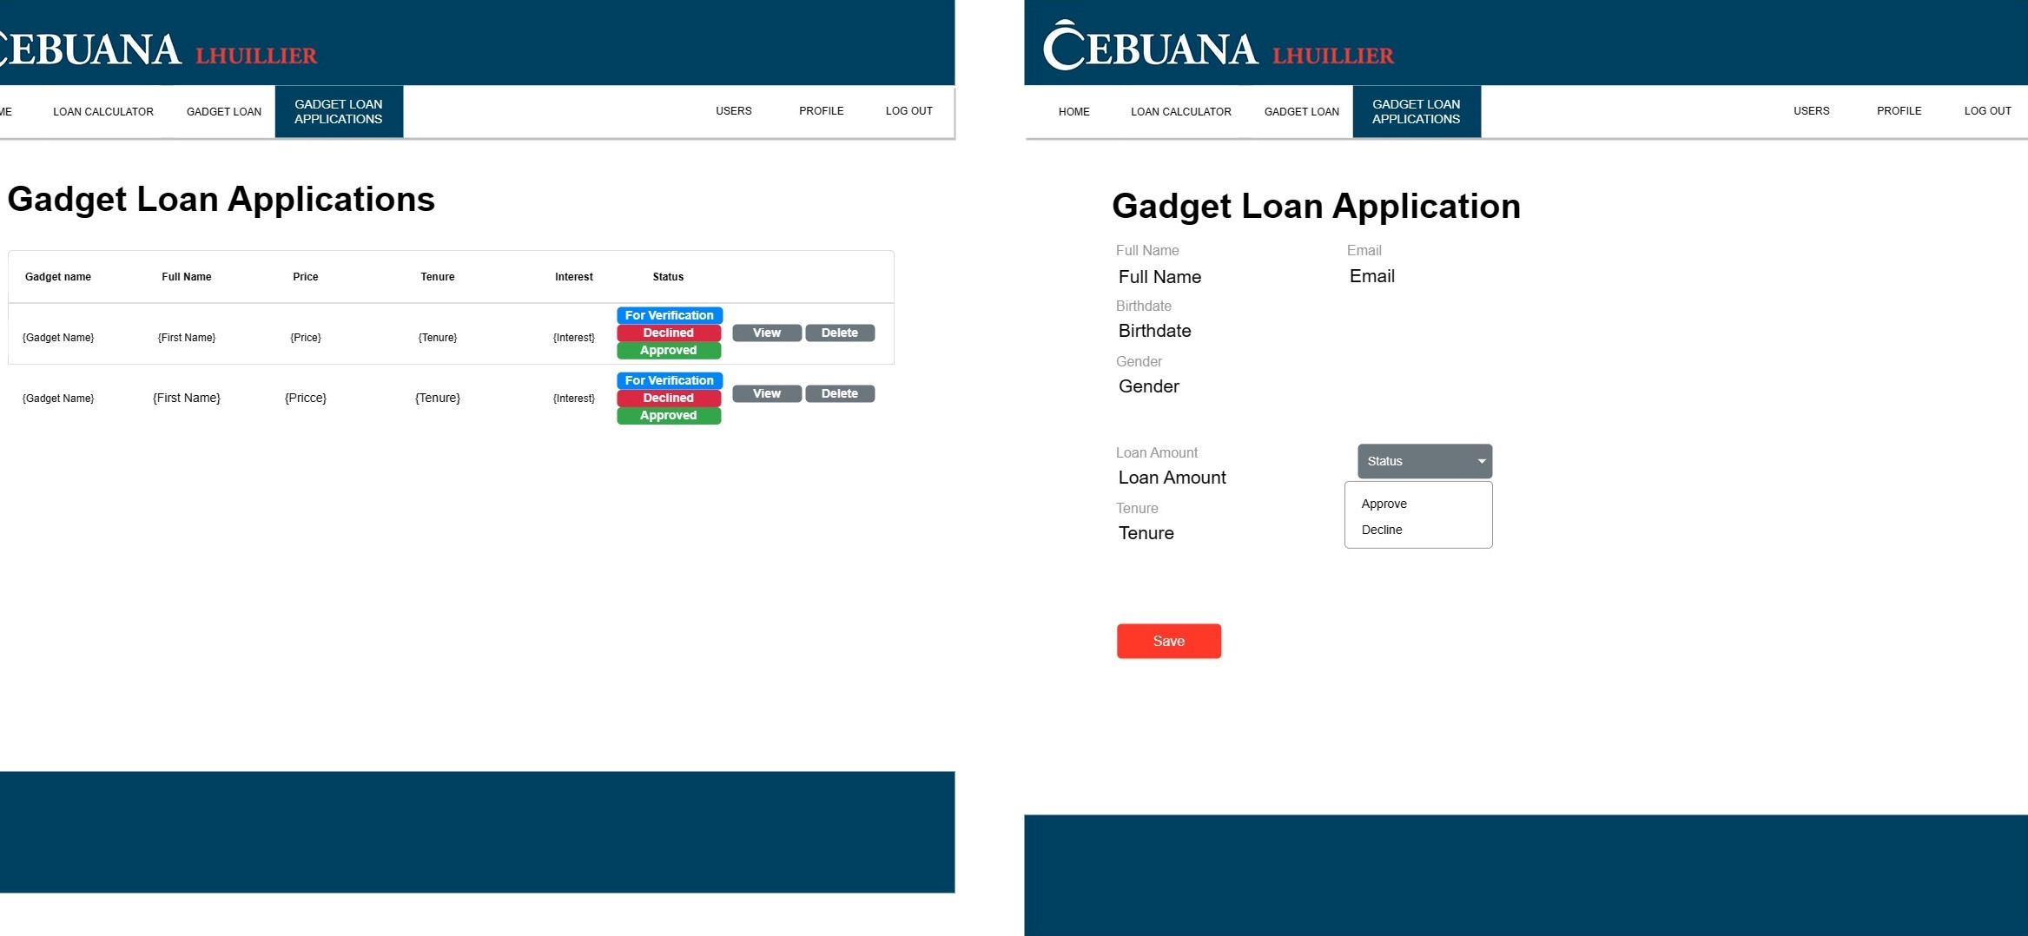
Wireframe

Slide 26
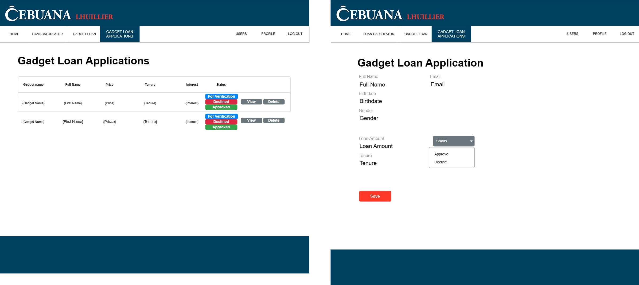
Wireframe

Slide 27
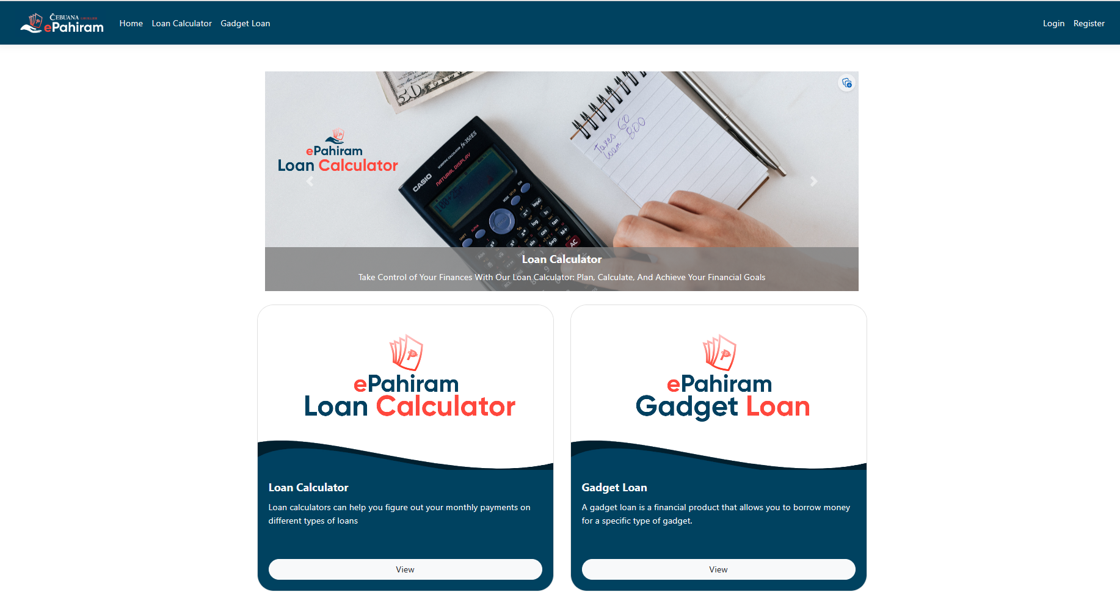
Important Features

Slide 28
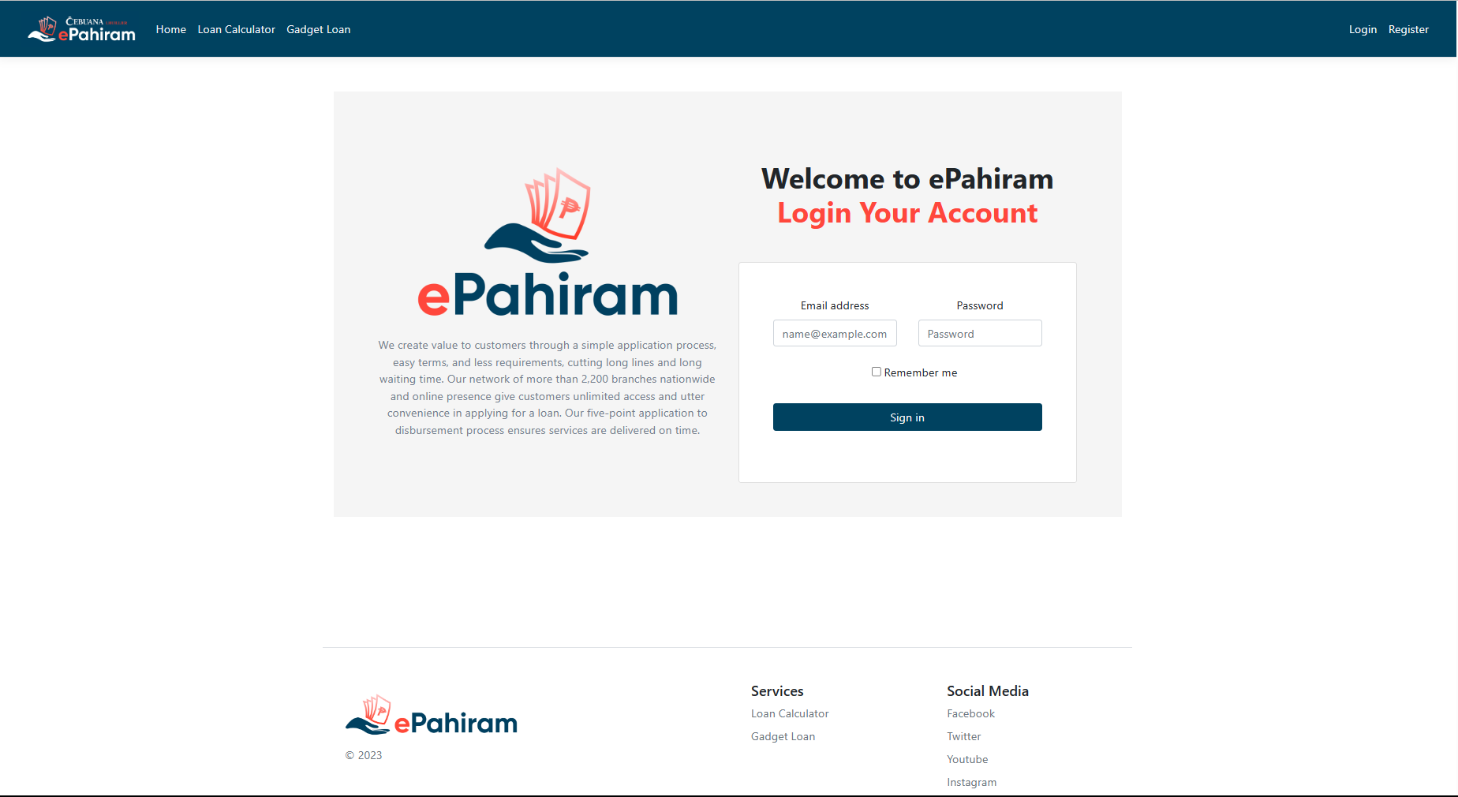
Important Features

Slide 29
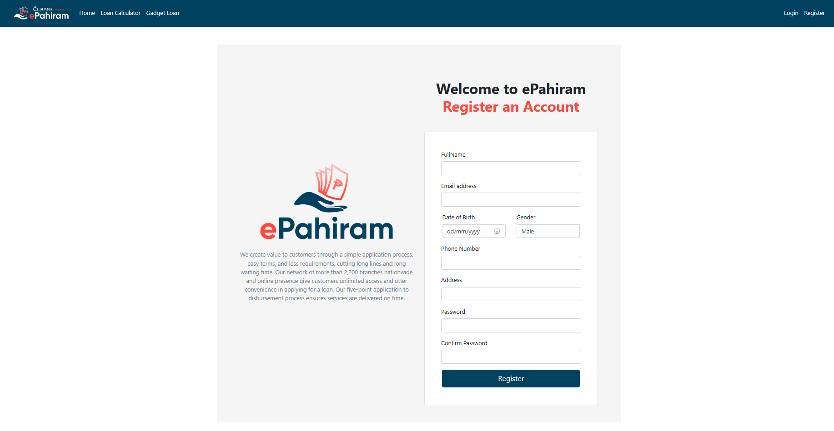
Important Features

Slide 30
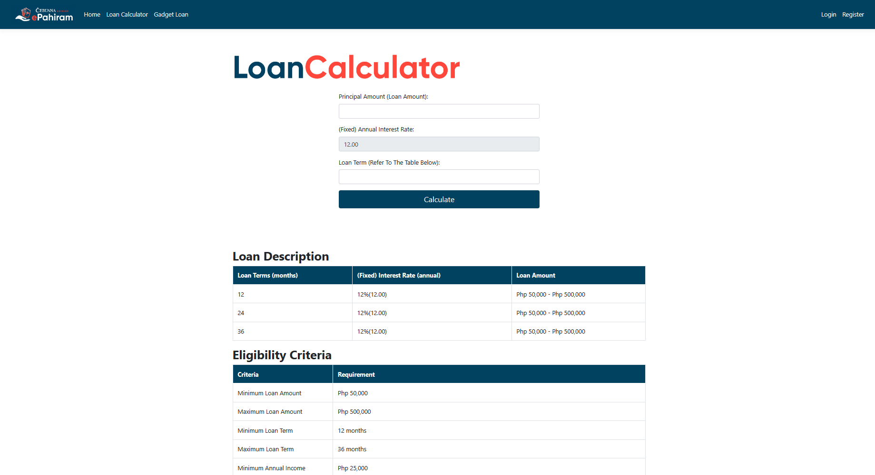
Important Features

Slide 31
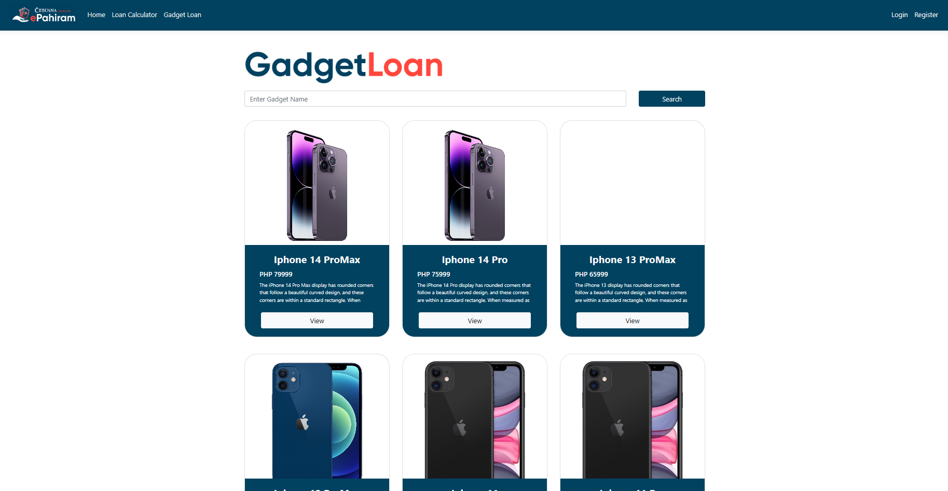
Important Features

Slide 32
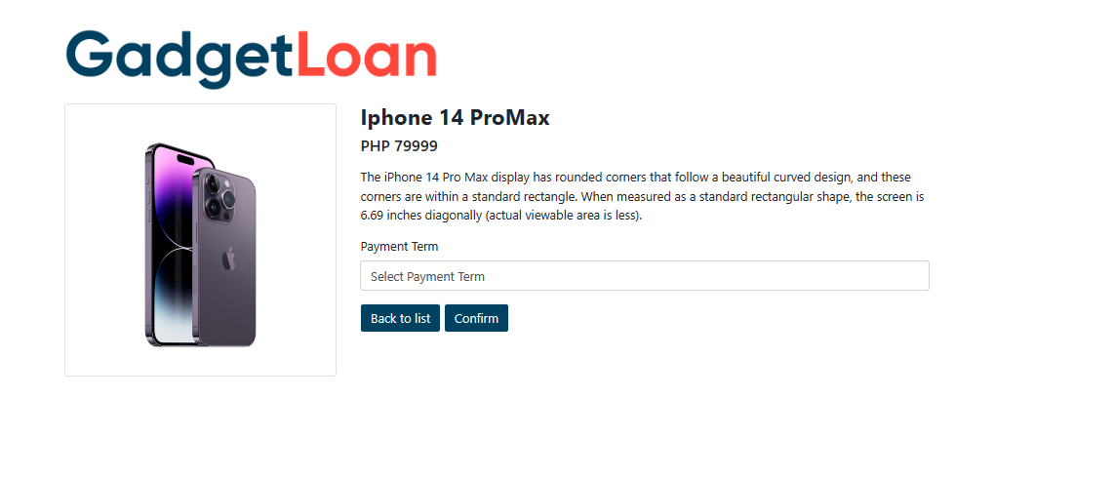
Important Features

Slide 33
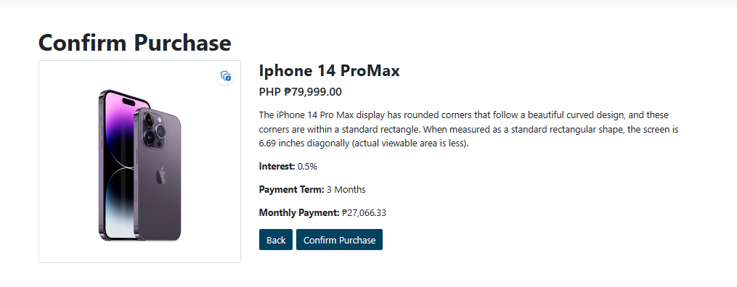
Important Features

Slide 34
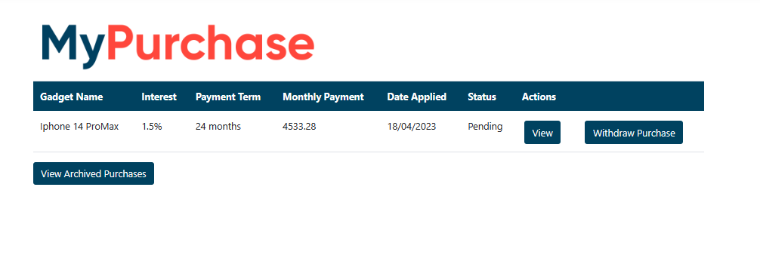
Important Features

Slide 35
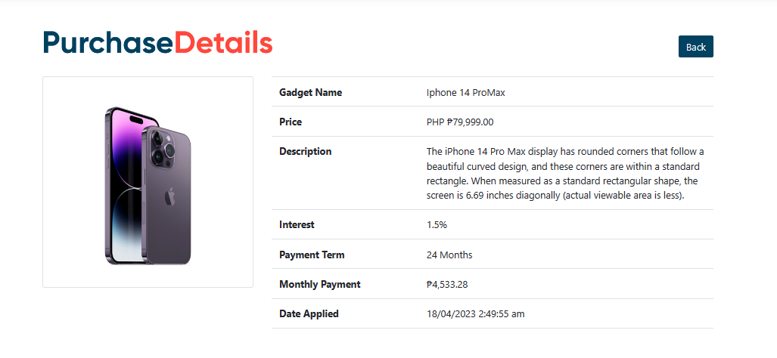
Important Features

Slide 36
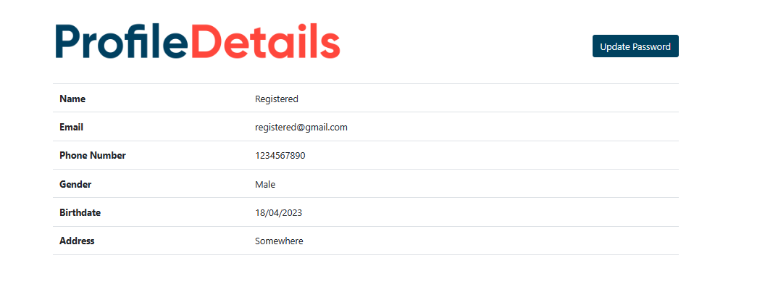
Important Features

Slide 37
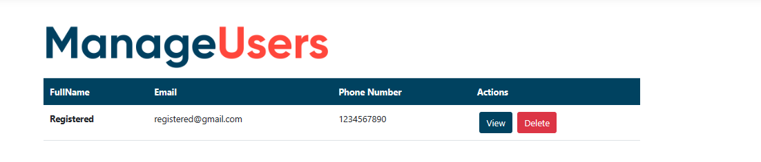
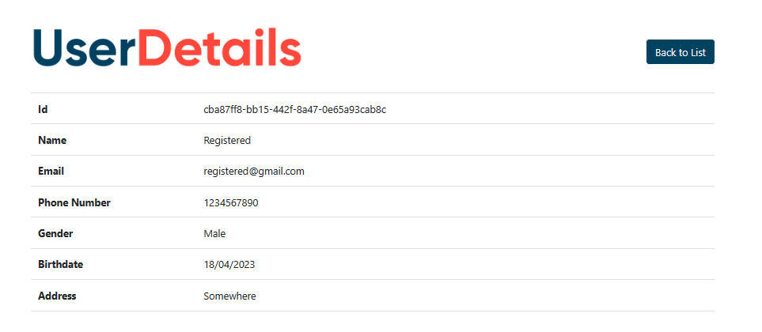
Important Features

Slide 38
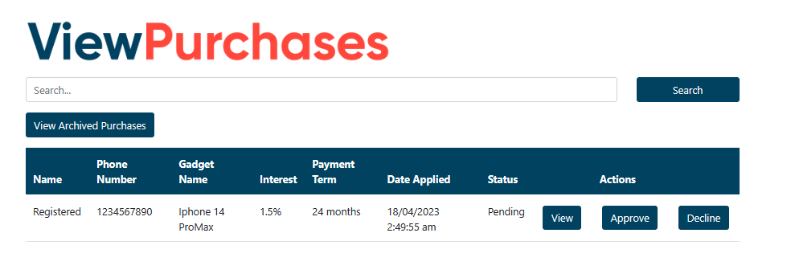
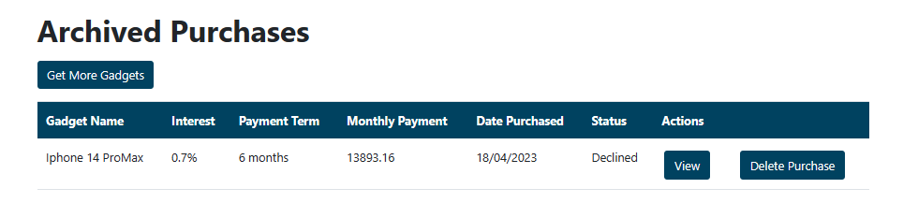
Important Features

Slide 39
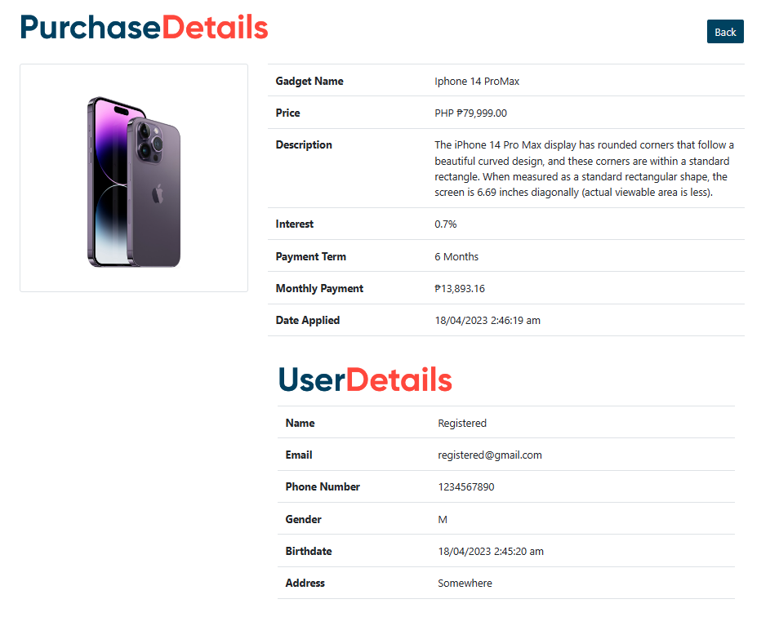
Important Features

Slide 40
Implementation
Future Enhancement:
Payment Options such as (Online Banking, Over the counter payment, and Cash payment thru PJLI)
Credit Score
Uploading of Ids and other valid documents
Delivery of Gadgets
Gadget Inventory
Other Loan Applications
UI Responsiveness

Slide 41
Conclusion
In conclusion, the ePahiram system represents a significant achievement in the development of loan management and calculation technology. With its Loan Calculator and Gadget Loan Application features, ePahiram provides a convenient and accessible solution for individuals who wish to keep up with the latest technology trends and to make informed decisions before applying for a loan. The system was built with several project deliverables, including ASP .NET Core 6.0 MVC, Web API, and SQL Server database

Slide 42
Thank You
www.collaberadigital.com

